Slide 1
Huawei ICT Competition Student Registration Guide
Security Level:

Slide 2
Content
Guest visits ICT Academy homepage
How to register for the competition(unregistered accounts)
How to register for the competition(registered accounts)
Replenishment Information

Slide 3
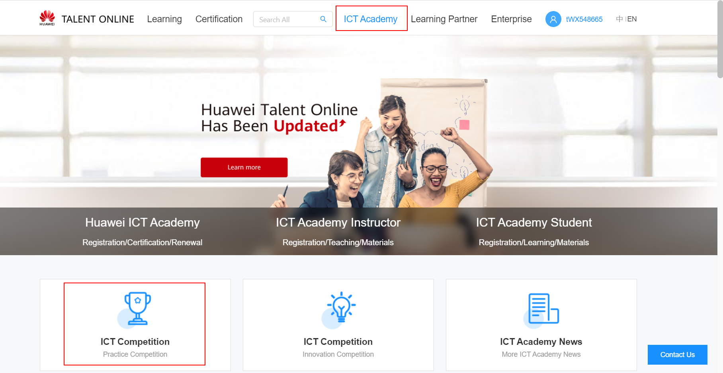
1. Guest visits ICT Competition homepage
① Visit https://e.huawei.com/en/talent/#/ict-academy/home?navType=talentAlliance ② Click “ICT Academy-ICT Competition” to enter the ICT Competition homepage.

Slide 4
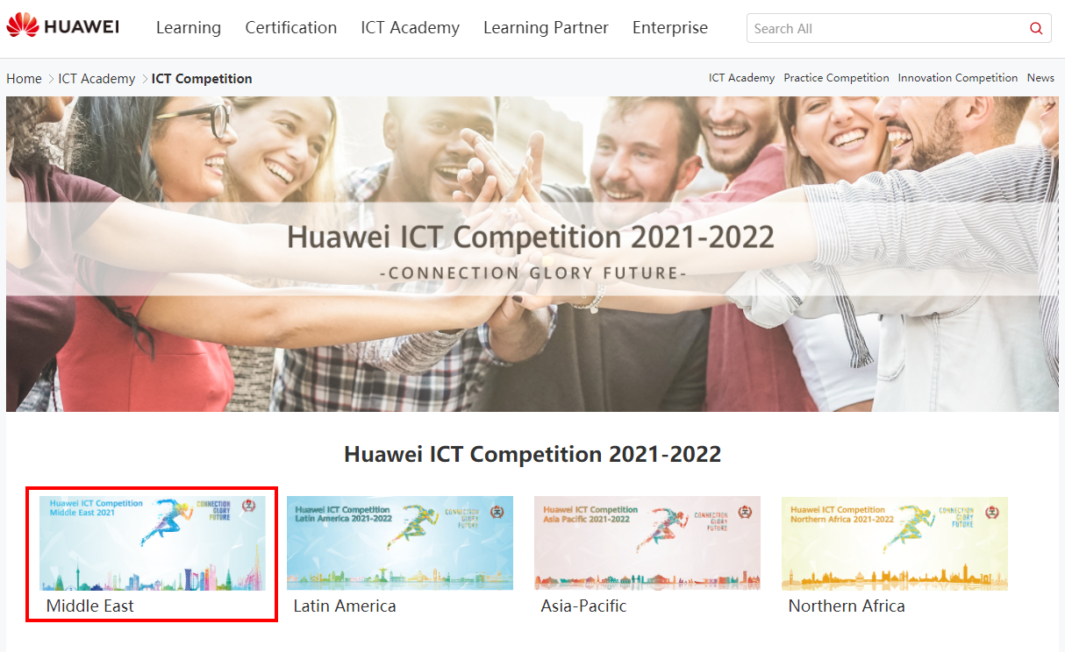
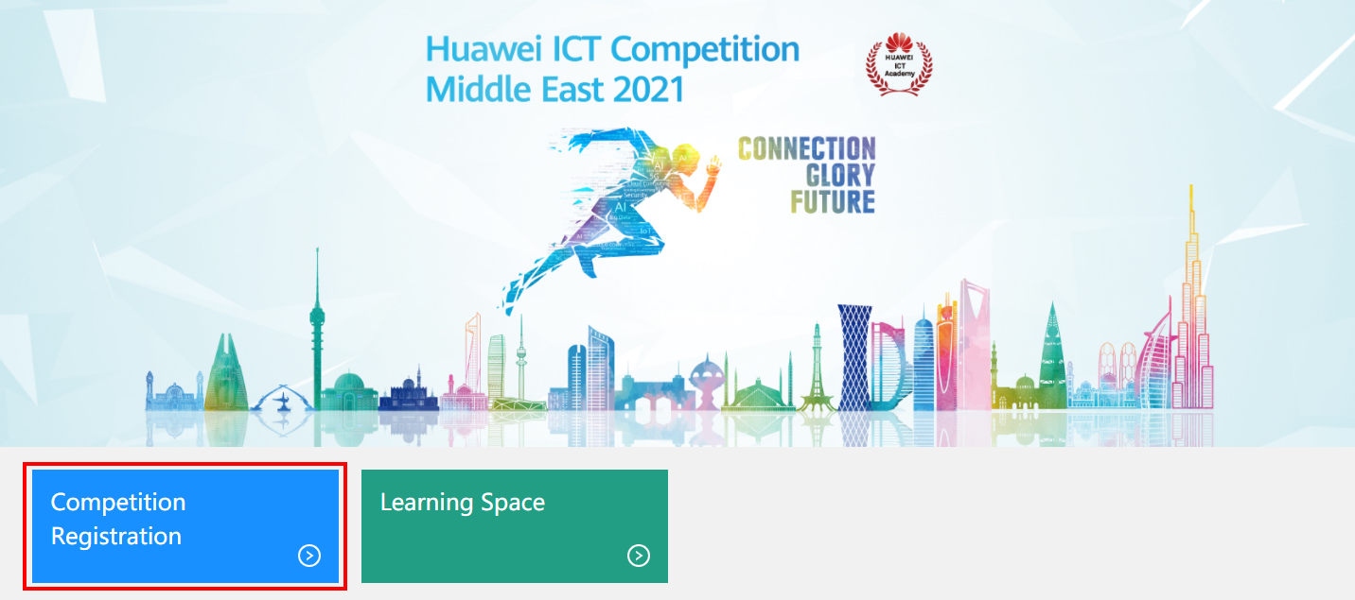
2. How to register for the competition(unregistered accounts)
Choose your regional competition.
Click“Competition Registration”to register.

Slide 5
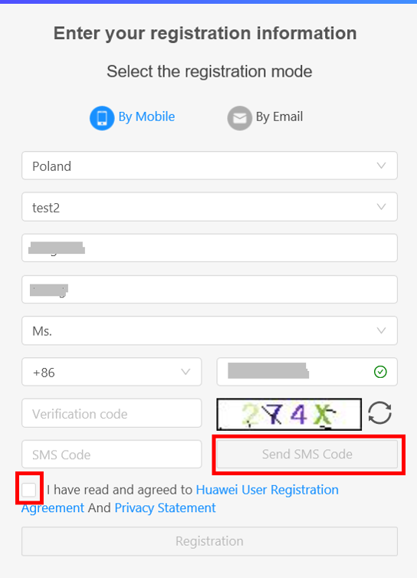
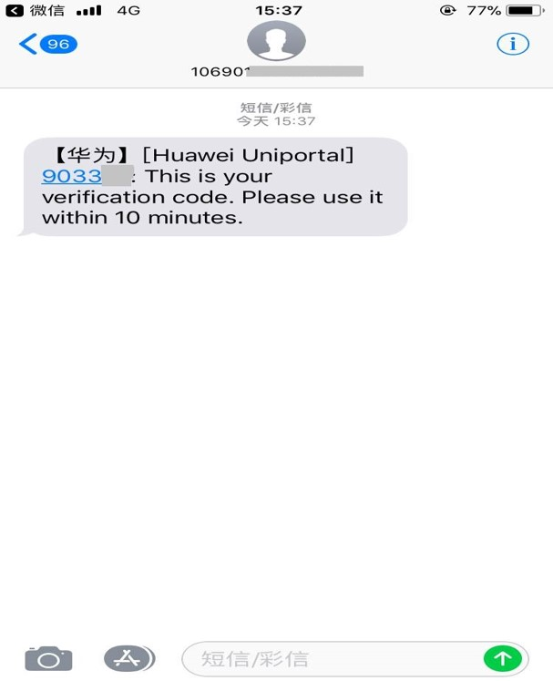
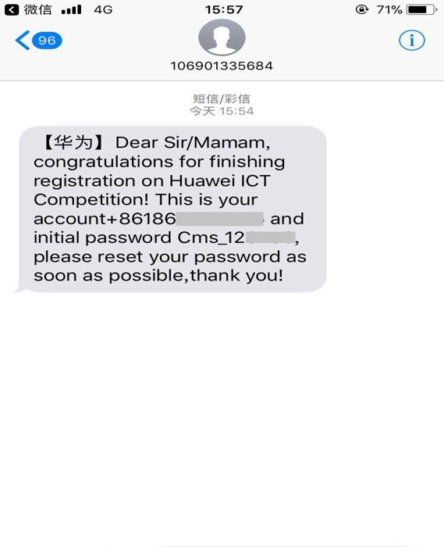
2. How to register for the competition(unregistered accounts)-Register by phone
Fill in your personal information - receive the mobile phone verification code and enter - registration is successful - receive the text message including the account and initial password.

Slide 6
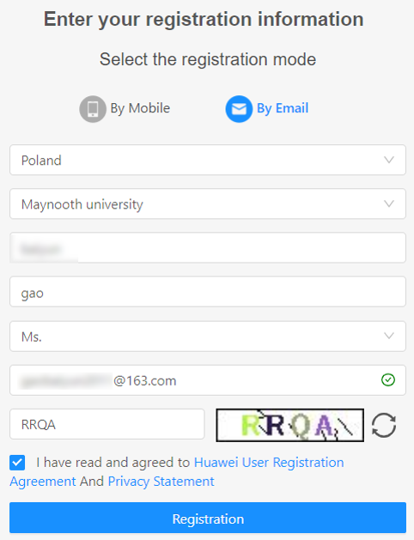
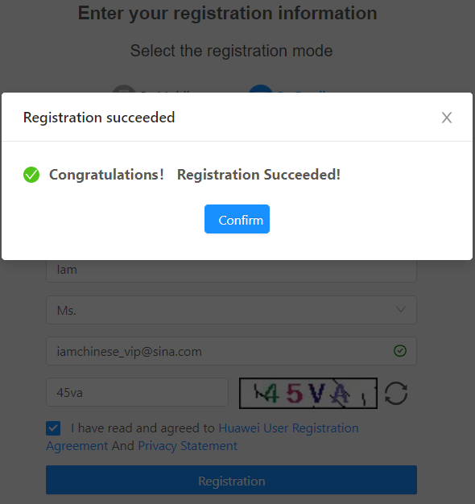
2. How to register for the competition(unregistered accounts)-Register by email
Fill in your personal information.

Slide 7
2. How to register for the competition(unregistered accounts)-Register by email
After successful registration you will receive two e-mail:
①Activate Uniportal account (does not include accounts that have already been activated)
Click to activate and jump to "talent"
②Provide account password and suggest reset

Slide 8
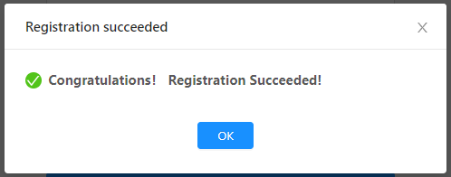
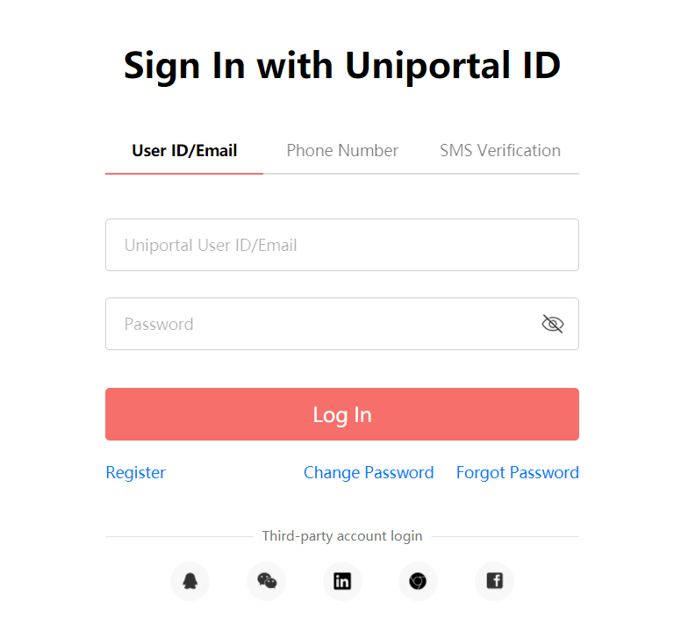
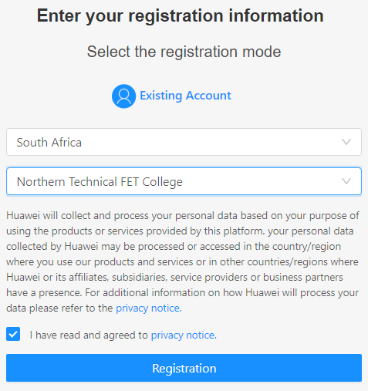
2. How to register for the competition(registered accounts)
1
5
2
3
4

Slide 9
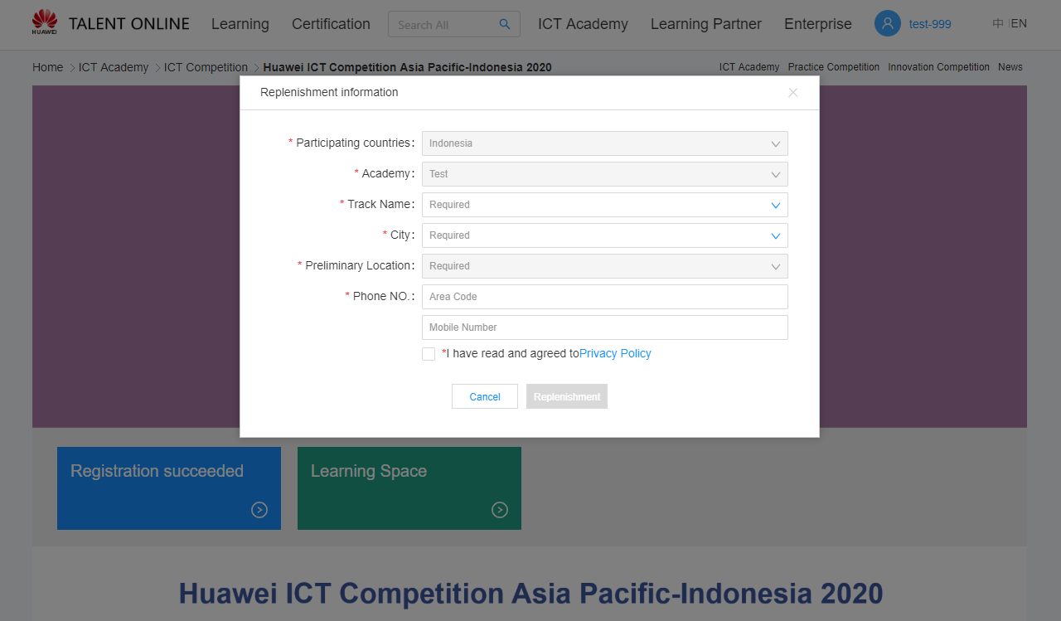
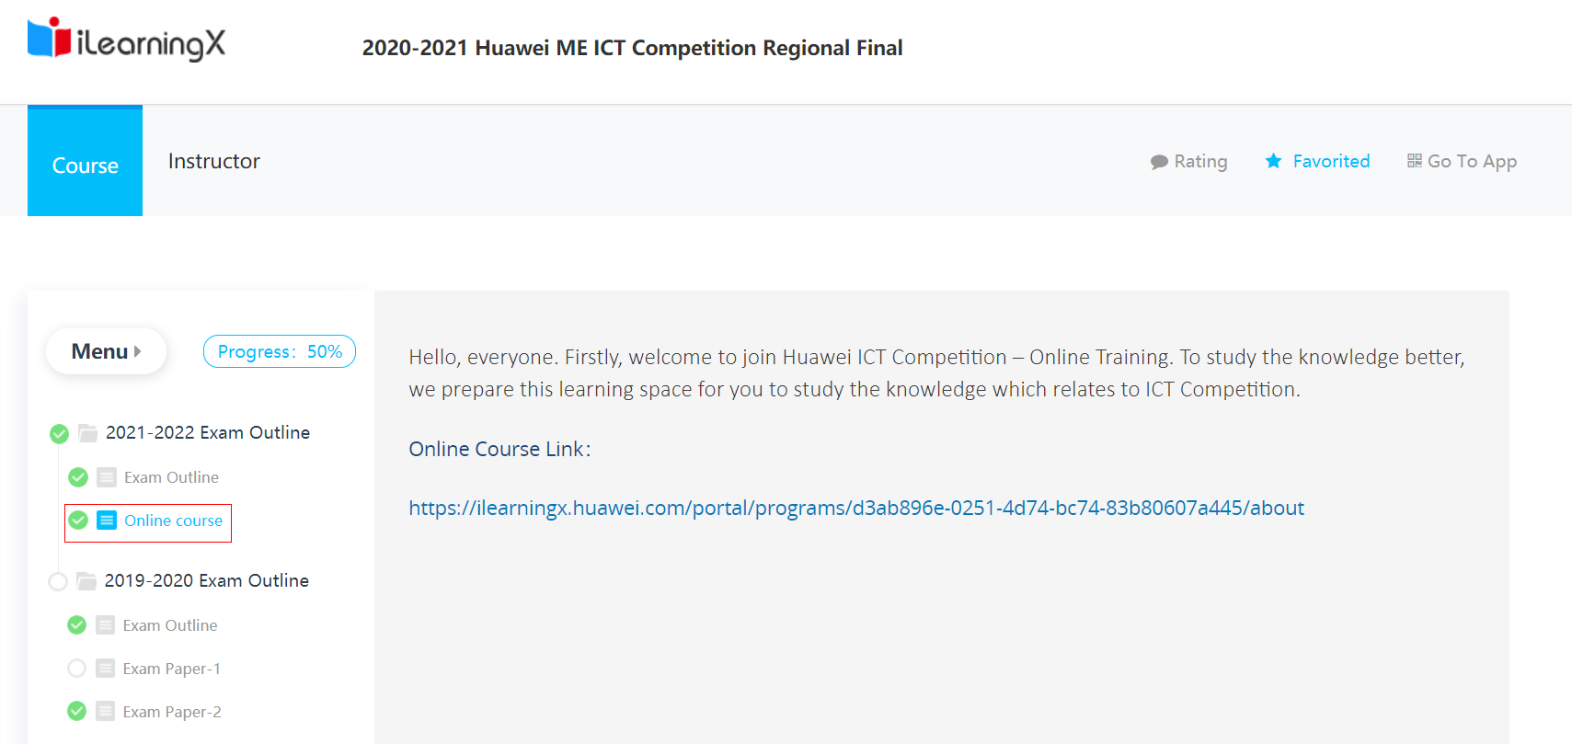
4. Replenishment Information
Complete your basic info and enter Learning Space
1
2
3

